Slide 1
Objective
Introduction to WebServices
Why we need Web Services
Introduction to Restful Services in Spring
Example with Eclipse

Slide 2
What is Web Service
A Web Service is can be defined by following ways:
is a client server application or application component for communication.
method of communication between two devices over network.
is a software system for interoperable machine to machine communication.
is a collection of standards or protocols for exchanging information between two devices or application.

Slide 3
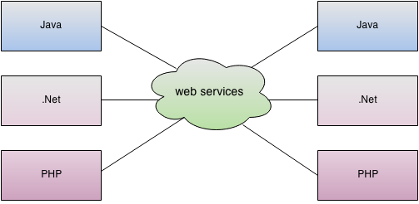
Architecture Of Web Service

Slide 4
Types of Web Services
There are mainly two types of web services.
SOAP web services.(Simple Object Access Protocol)
RESTful web services.(REpresentational State Transfer.)
Web Service Components
There are three major web service components.
SOAP (Simple Object Access Protocol)
WSDL (Web Services Description Language.)
UDDI (Universal Description, Discovery and Integration.)

Slide 5
WSDL
WSDL is a xml document containing information about web services such as method name, method parameter and how to access it.
UDDI
UDDI is a XML based framework for describing, discovering and integrating web services.
UDDI is a directory of web service interfaces described by WSDL, containing information about web services.
Note:
REST more preferred than SOAP.

Slide 6
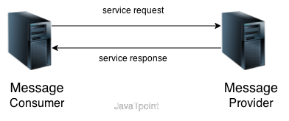
Service Connections

Slide 7
REST Web service
There are two main implementation of JAX-RS API (REST).
Jersey
RESTEasy

Slide 8
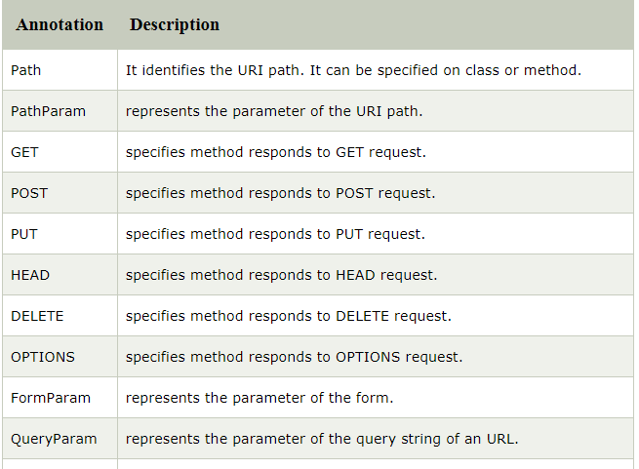
JAX-RS Annotations

Slide 9
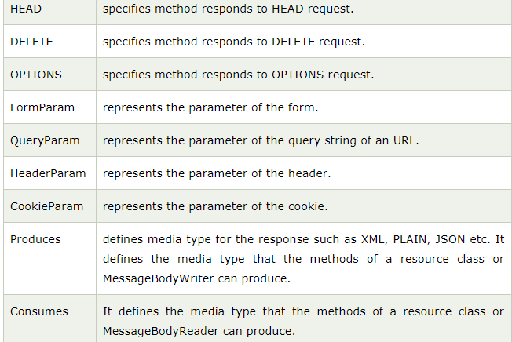

Slide 10
Summary
In this Session, you have learnt how to use web services.
However, a web service also include components such as WSDL, UDDI, and SOAP that contribute to make it active
Types of web services
Uses of web services

Slide 11
Videos link
https://www.youtube.com/watch?v=iB3NNW1zl44
https://www.youtube.com/watch?v=68NuOrSerT8
https://www.youtube.com/watch?v=EfEUDAHgrGQ

